Slide 1
RUNGTA COLLEGE OF DENTAL SCIENCES & RESEARCH
TITLE OF THE TOPIC – DENTIN HYPERSENSITIVITY
DEPARTMENT OF CONSERVATIVE DENTISTRY AND ENDODONTICS

Slide 2
Specific learning Objectives
At the end of this presentation the learner is expected to know ;
Core areas* | Domain ** | Category #
Theories | Cognitive | Must know
Etiology | Cognitive | Must know
Treatment strategies | Psychomotor | Nice to know
*Subtopic of importance
** Cognitive, Psychomotor or Affective
# Must know , Nice to know & Desire to know
( Table to be prepared as per the above format )

Slide 3
Content
• Definition
• Neurophysiology of Teeth
• Mechanism of Dentin Sensitivity
• Incidence and Distribution of Dentin Hypersensitivity
• Etiology and Predisposing Factors
• Differential Diagnosis
• Diagnosis
• Treatment Strategies

Slide 4
INTRODUCTION
Dentin hypersensitivity is defined as “sharp, short pain arising from exposed dentin in response to stimuli typically thermal, chemical, tactile or osmotic and which cannot be ascribed to any other form of dental defect or pathology (Holland et al, 1997).

Slide 5
HISTORIC REVIEW
Leeuwenhoek (1678) described “tooth canals in dentin”
JD White (1855) proposed that dentinal pain was caused by movement of fluid in dentinal tubules
Lukomsky (1941) advocated sodium fluoride as a desensitizing obtundent
Brannstrom (1962) described hydrodynamic theory of dentinal pain
Kleinberg (1986) summarized different approaches that are used to treat hypersensitivity.

Slide 6
NEUROPHYSIOLOGY OF TEETH
The dental pulp is richly innervated.
According to conduction velocities, the nerve units can be classified into
A group—having the conduction velocity more than 2 m/s and C group—with conduction velocity less than 2 m/s.
The sharp, better localized pain is mediated by A delta fibers, whereas C fiber activation seems to be connected with the dull radiating pain sensation.
Myelinated A fiber seems to be responsible for dentin sensitivity.

Slide 7
MECHANISM OF DENTIN SENSITIVITY
Theories of Dentin Sensitivity
Neural theory
Odontoblastic transduction theory
Hydrodynamic theory.
Neural Theory
The neural theory attributes to activation of nerve ending lying within the dentinal tubules.
These nerve signals are then conducted along the parent primary afferent nerve fibers in the pulp, into the dental nerve branches and then into the brain.
Neural theory considered that entire length of tubule contains free nerve endings.

Slide 8
Odontoblastic Transduction Theory
The theory assumed that odontoblasts extend to the periphery.
The stimuli initially excite the process or body of the odontoblast.
The membrane of odontoblasts may come into close apposition with that of nerve endings in the pulp or in the dentinal tubule and the odontoblast transmits the excitation of these associated nerve endings.
However, in the most recent study; Thomas (1984) indicated that the odontoblastic process is restricted to the inner third of the dentinal tubules.
Accordingly it seems that the outer part of the dentinal tubules does not contain any cellular elements but is only filled with dentinal fluid.

Slide 9
Hydrodynamic Theory
This theory proposes that a stimulus causes displacement of the fluid that exists in the dentinal tubules.
The displacement occurs in either an outward or inward direction and this mechanical disturbance activates the nerve endings present in the dentin or pulp.
Brannstrom (1962) suggested that the displacement of the tubule contents is rapid enough to deform nerve fiber in pulp or predentin or damage odontoblast cell.
Both of these effects appear capable of producing pain.
Currently most investigators accept that dentin sensitivity is due to the hydrodynamic fluid shift, which occurs across exposed dentin with open tubules.
This rapid fluid movement in turn activates the mechanoreceptor nerves of A group in the pulp.

Slide 10
Mathews et al (1994) noted that stimuli such as cold causes fluid flow away from the pulp, produces more rapid and greater pulp nerve responses than those such as heat, which causes an inward flow.
This certainly would explain the rapid and severe response to cold stimuli compared to the slow dull response to heat.
The dehydration of dentin by air blasts or absorbent paper causes outward fluid movement and stimulates the mechanoreceptor of the odontoblast, causing pain.
Prolonged air blast causes formation of protein plug into the dentinal tubules, reducing the fluid movement and thus decreasing pain .

Slide 11
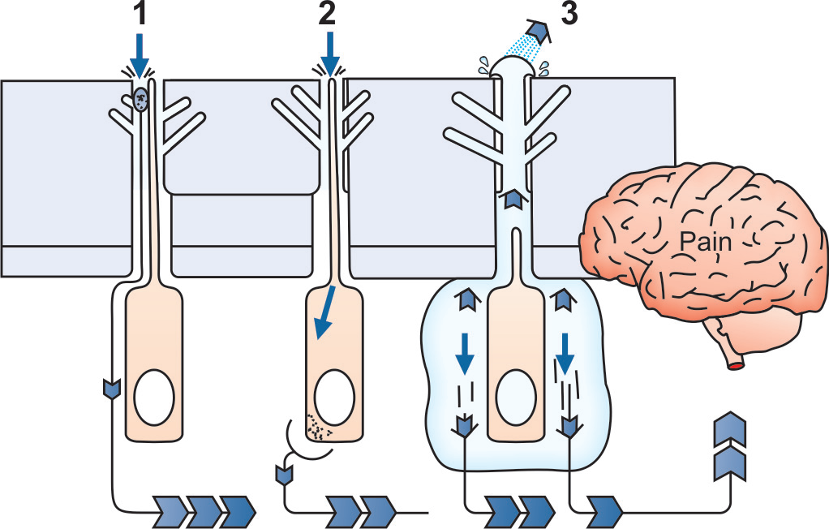
Theories of dentin hypersensitivity. (1) Neural theory: Stimulus applied to dentin causes direct excitation of the nerve fibers,
(2) Odontoblastic transduction theory: Stimulus is transmitted along the odontoblast and passes to the sensory nerve endings through synapse,
(3) Hydrodynamic theory: Stimulus causes displacement of fluid present in dentinal tubules which further excite nerve fibers

Slide 12
INCIDENCE AND DISTRIBUTION OF DENTIN HYPERSENSITIVITY
The prevalence studies for dentin hypersensitivity are limited in number.
The available prevalence data varies considerably and dentin hypersensitivity has been stated to range from 8 to 30 percent of adult population.
Most sufferers range from 20-40 years of age and a peak occurrence is found at the end of the third decade.
In general, a slightly higher incidence of dentin hypersensitivity is reported in females than in males.
The reduced incidence of dentin hypersensitivity in older individuals reflects age changes in dentin and the dental pulp.
Sclerosis of dentin, the laying down of secondary dentin and fibrosis of the pulp would interfere with the hydrodynamic transmission of stimuli through exposed dentin.

Slide 13
Intraoral Distribution
Hypersensitivity is most commonly noted on buccal cervical zones of permanent teeth.
Although all tooth type may be affected, canines and premolars in either jaw are the most frequently involved.
Regarding the side of mouth, in right handed tooth brushers, the dentin hypersensitivity is greater on the left sided teeth compared with the equivalent contralateral teeth.

Slide 14
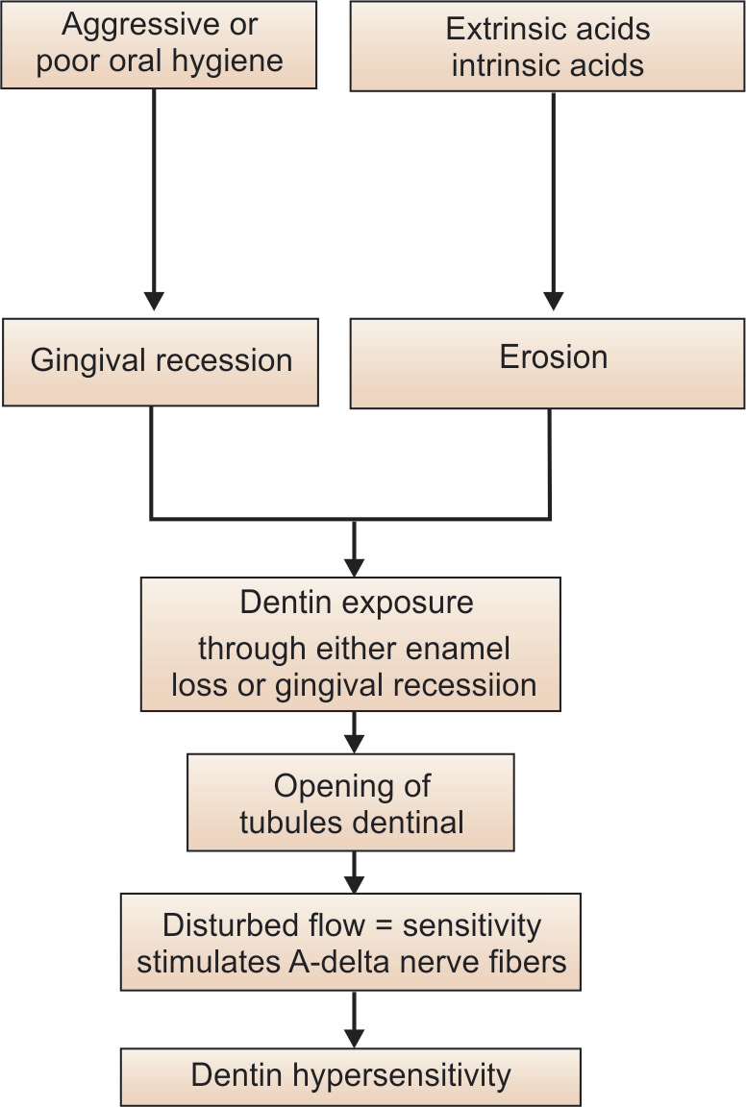
ETIOLOGY AND PREDISPOSING FACTORS

Slide 15
The primary underlying cause for dentin hypersensitivity is exposed dentinal tubules.
Dentin may become exposed by two processes;
1.either by loss of covering periodontal structures (gingival recession), or
2. by loss of enamel.
The most common clinical cause for exposed dentinal tubules is gingival recession.
Common reasons for gingival recession
.Inadequate attached gingiva
.Prominent roots
.Toothbrush abrasion

Slide 16
.Oral habits resulting in gingiva laceration, i.e. traumatic tooth picking, eating hard foods
.Excessive tooth cleaning
.Excessive flossing
.Gingival recession secondary to specific diseases, i.e. NUG, periodontitis, herpetic gingivostomatitis
.Crown preparation.

Slide 17
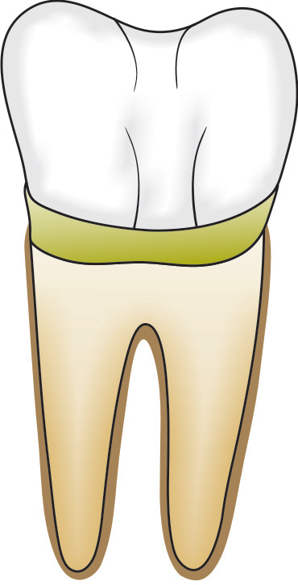
The recession may or may not be associated with bone loss.
If bone loss occurs, more dentinal tubules get exposed.
When gingival recession occurs, the outer protective layer of root dentin, i.e. cementum gets abraded or eroded away.
This leaves the exposed underlying dentin, which consists of protoplasmic projections of odontoblasts within the pulp chamber.
These cells contain nerve endings and when disturbed, nerves depolarize and this is interpreted as pain.
Once the dentinal tubules are exposed, there are oral processes which keep them exposed.

Slide 18
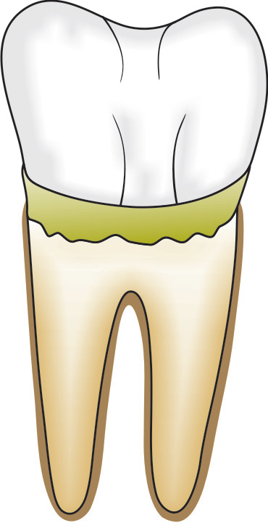
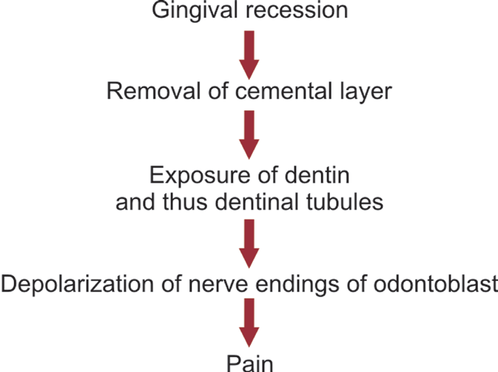
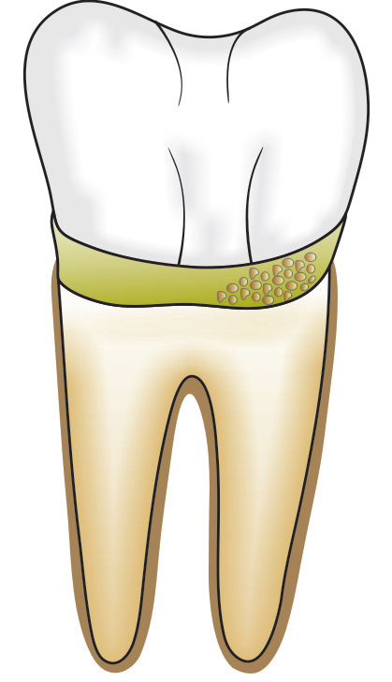
These include poor plaque control, enamel wear, improper oral hygiene technique, cervical erosions, enamel wear and exposure to acids.

Slide 19
Reasons for continued dentinal tubular exposure
Poor plaque control, i.e. acidic bacterial byproducts
Excess oral acids, i.e. soda, fruit juice,
swimming pool chlorine,
bulimia
Cervical decay
Toothbrush abrasion
Tartar control toothpaste.
The other reason for exposure of dentinal tubules is due to loss of enamel.
Causes of loss of enamel
Attrition by exaggerated occlusal functions like bruxism
Abrasion from dietary components or improper brushing technique
Erosion associated with environmental or dietary components particularly acids.
Since dentinal tubules get sclerosed of their own and plug themselves up in the oral environment, treatment should focus on eliminating factors associated with continued dentinal exposure.

Slide 20
DIFFERENTIAL DIAGNOSIS
Dentin hypersensitivity is perhaps a symptom complex rather than a true disease and results from stimulus transmission across exposed dentin.
A number of dental conditions are associated with dentin exposure and therefore, may produce the same symptoms.
Such conditions include:
• Chipped teeth
• Fractured restoration
• Restorative treatments
• Dental caries
• Cracked tooth syndrome
• Other enamel invaginations.

Slide 21
DIAGNOSIS
• A careful history together with a thorough clinical and radiographic examination is necessary before arriving at a definitive diagnosis of dentin hypersensitivity. However, the problem may be made difficult when two or more conditions coexist.
• Tooth hypersensitivity differs from dentinal or pulpal pain. In case of dentin hypersensitivity, patient’s ability to locate the source of pain is very good, whereas in case of pulpal pain, it is very poor.
• The character of the pain does not outlast the stimulus; the pain is intensified by thermal changes, sweet and sour.
• Intensity of pain is usually mild to moderate.
• The pain can be duplicated by hot or cold application or by scratching the dentin. The pulpal pain is explosive, intermittent and throbbing and can be affected by hot or cold.

Slide 22
TREATMENT STRATEGIES
Hypersensitivity can resolve without the treatment or may require several weeks of desensitizing agents before improvement is seen.
Treatment of dentin hypersensitivity is challenging for both patient and the clinician mainly for two main reasons:
1. It is difficult to measure or compare pain among different patients.
2. It is difficult for patient to change the habits that initially caused the problem.

Slide 23
TAKE HOME MESSEGE/ FOR THE TOPIC COVERED (SUMMARY)
• A careful history together with a thorough clinical and radiographic examination is necessary before arriving at a definitive diagnosis of dentin hypersensitivity. However, the problem may be made difficult when two or more conditions coexist.
• Tooth hypersensitivity differs from dentinal or pulpal pain. In case of dentin hypersensitivity, patient’s ability to locate the source of pain is very good, whereas in case of pulpal pain, it is very poor.

Slide 24
Question & Answer Session
Short note on ACP- CPP
Theories of dentinal hypersensitivity.
Short note on dentrifices.

Slide 25
REFERENCES
ORBAN’S HISTOLOGY AND EMBRYOLOGY 12TH EDITION
ANTONIO NANCI- TEN CATE’S ORAL HISTOLOGY- DEVELOPMENT STRUCTURE AND FUNCTION- 6TH EDITION

Slide 26
THANK YOU

